Slide 1


Bike Sharing
PREPARED BY GROUP 5

Slide 2




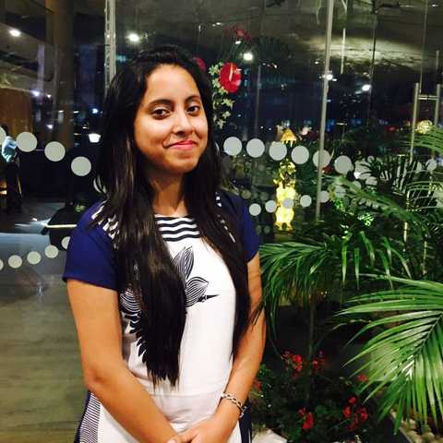
The Team
Helping the GoBike analyse their customer data
Sakshi Khadayate
Shubham Bhutada
Unnati Ghodki
Anshita Aishwarya
Data Enthusiast
(Love Numbers)
Critical Thinker
(Questions Everything)
Problem Solver
(Thrives on problems)
Vizard
(Love Visualisations)

Slide 3
Project Timeline and Tasks
JANUARY
Brainstorming
FEBRUARY
Data Selection
Data Cleaning/Wrangling
Data Analysis
R Coding
MARCH
Presentation

Slide 4
About
Our Client
40000+ Paying
Customers
GoBike is a is a bicycle sharing system in the Boston metropolitan area. It offers eligible riders a fun and affordable transportation option
250+ stations across Boston
Bikes are used on
480+ routes
3000+ Bikes

Slide 5
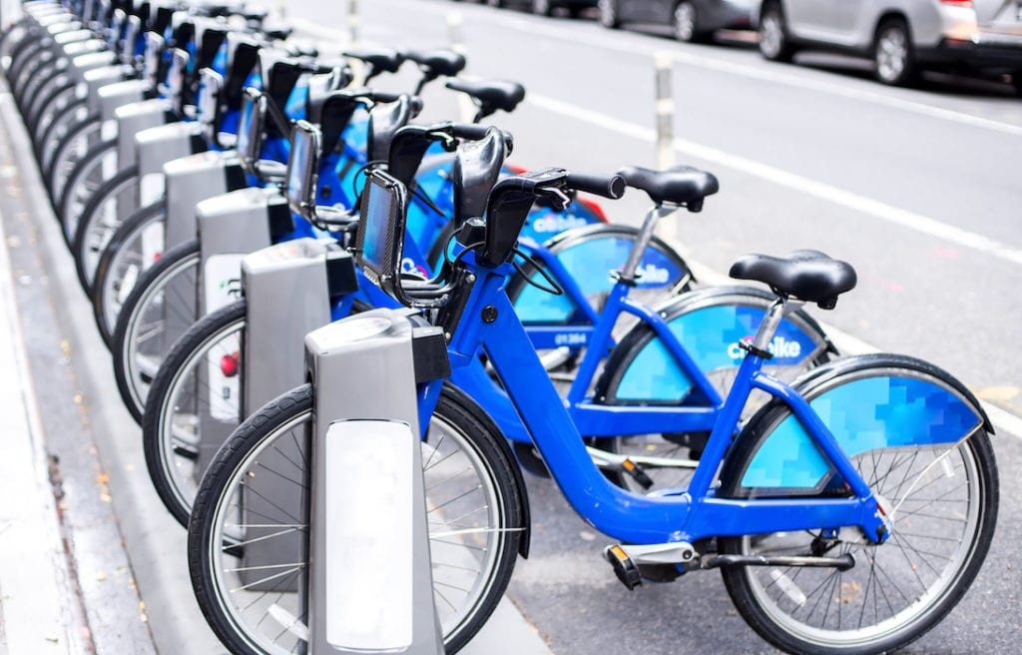
Data Description
50
40
30
20
10
0
Item 1
Item 2
Item 3
Item 4
Item 5
This dataset contains the hourly and daily count of rental bikes between years 2020 and 2021 for Go-Bike company with the corresponding weather and seasonal information.
(17K+ records, 30 Attributes)

Slide 6
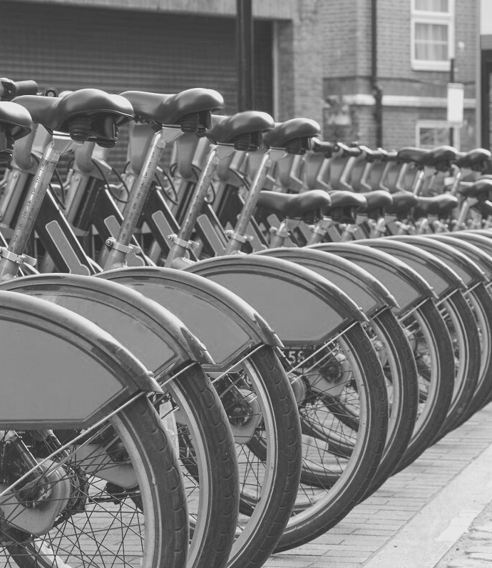

Problem Statement
Company wants to improve existing business and make it robust for planning an expansion based on the historical data.

Slide 7
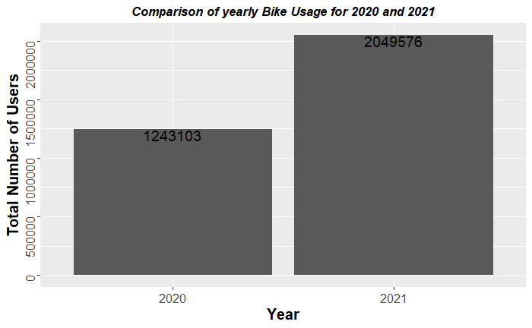

Year-Wise Users
From 2020 to 2021we see a whopping 65% YOY increase in the number of users (Registered and Unregistered)

Slide 8
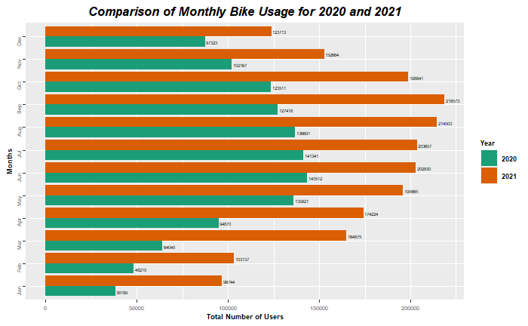
Year-Wise Comparison
The distribution of number of users follows the same trend in both years
These trends are based on the weather and seasonal changes

Slide 9
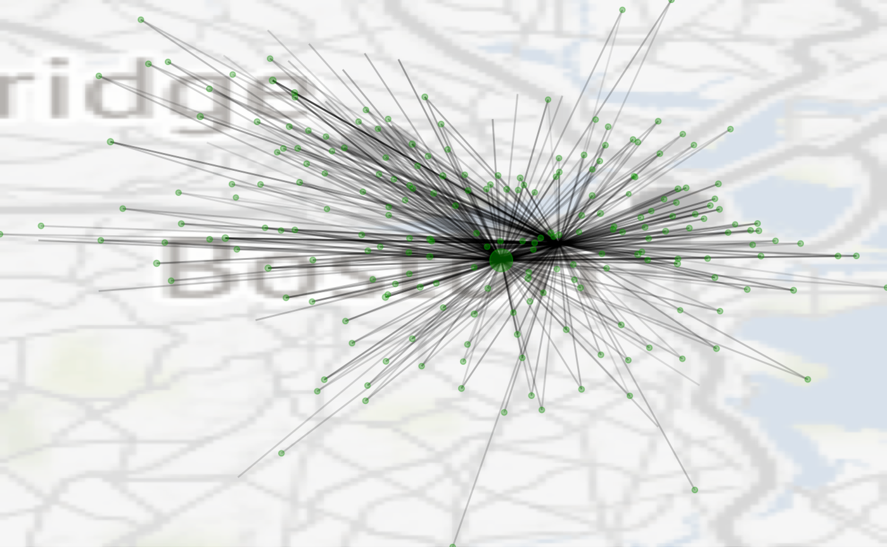
Bike Routes Network
The bike stations owned by GoBike are distrubuted throughout Boston
Back Bay
More than 250 stations are spread across the city
CSP

Slide 10
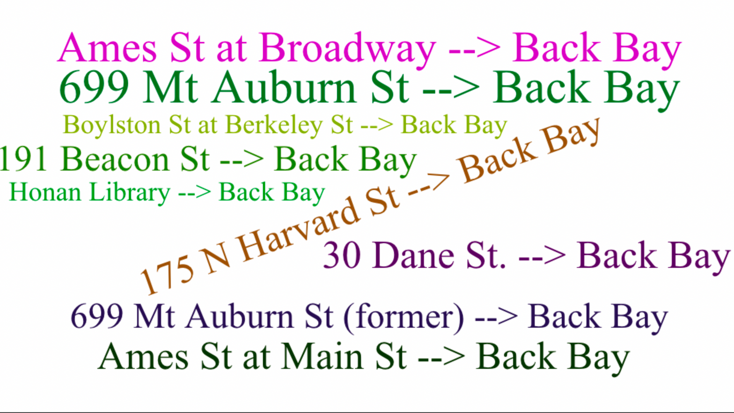

Widely Used Routes
Most commonly used route based on the number of people traveling between these stations
More people
Bigger size of the name

Slide 11
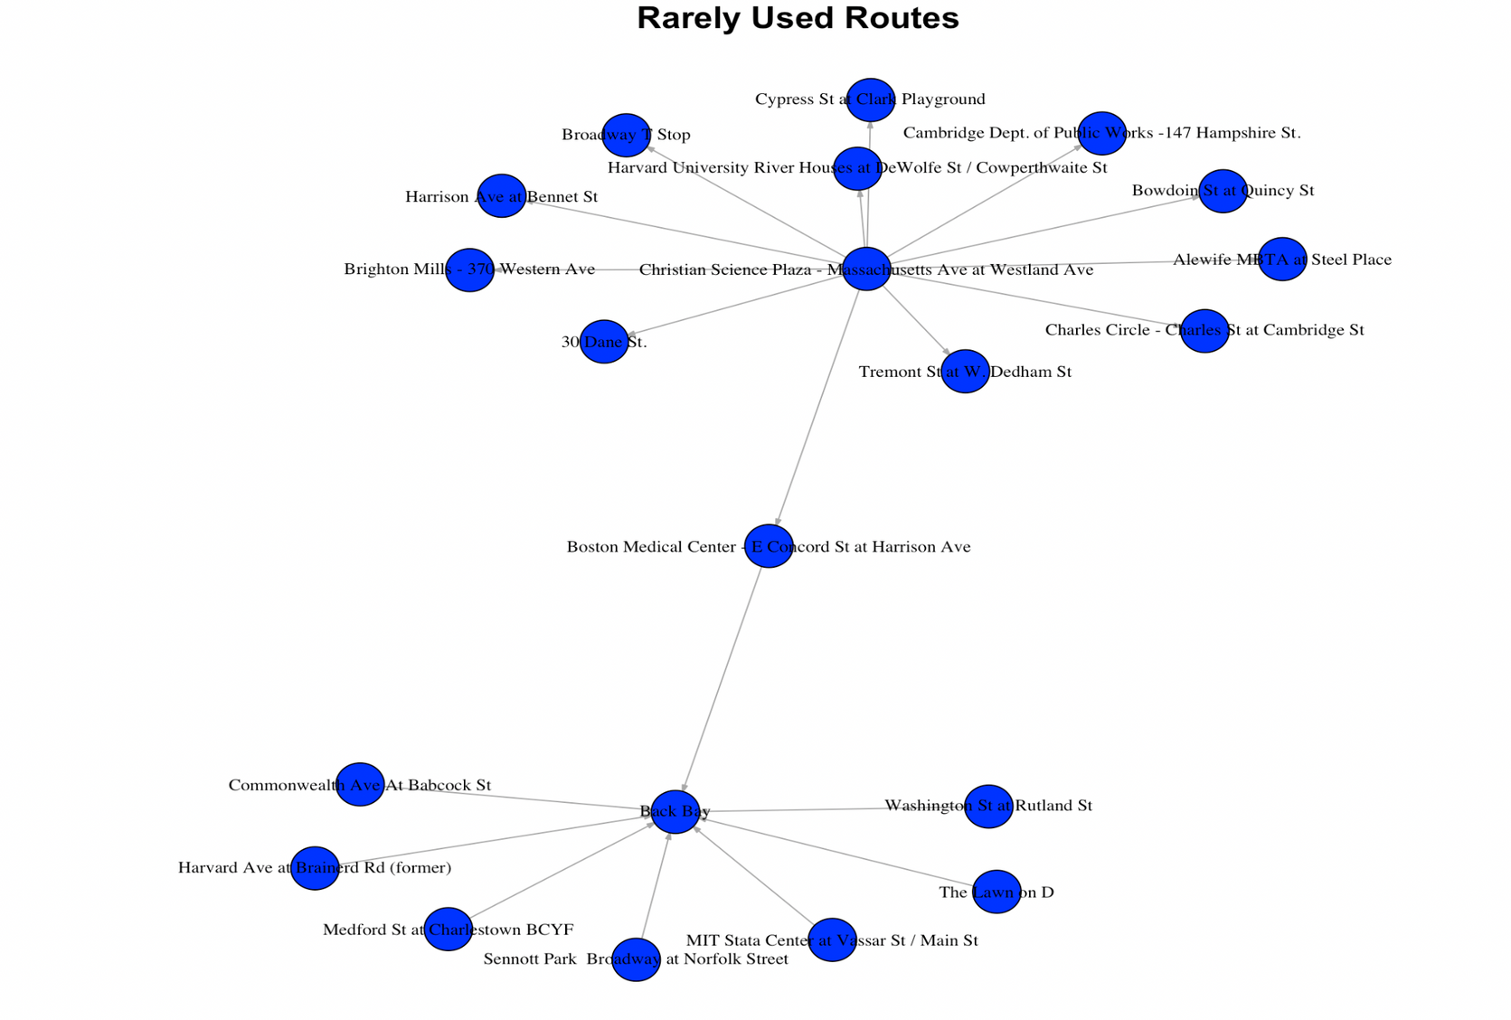
Least Used Routes

Slide 12
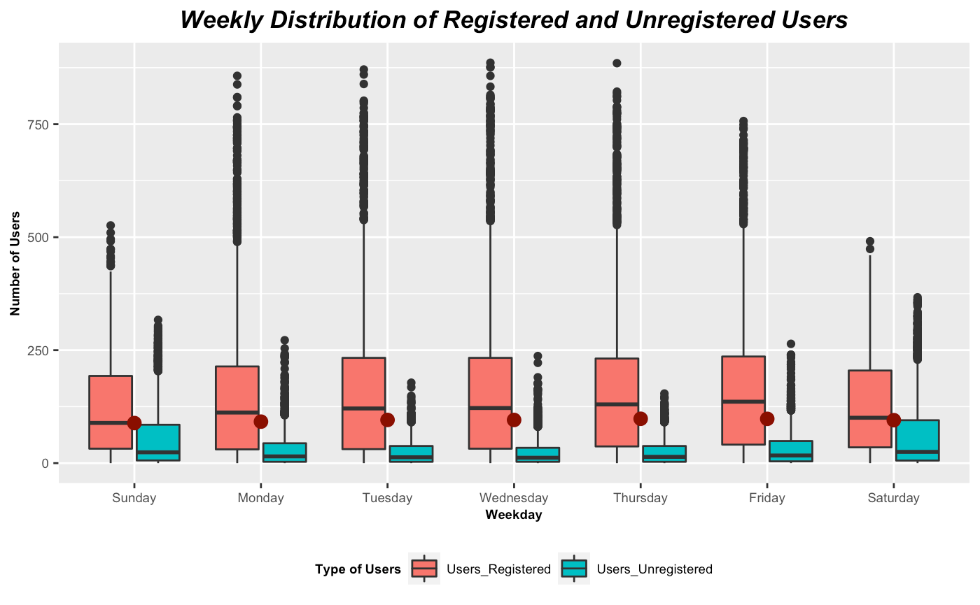

Weekday-Wise Usage
Weekdays show a huge number of users and weekends are comparatively slow for business.
Why do you think there are outliers????

Slide 13
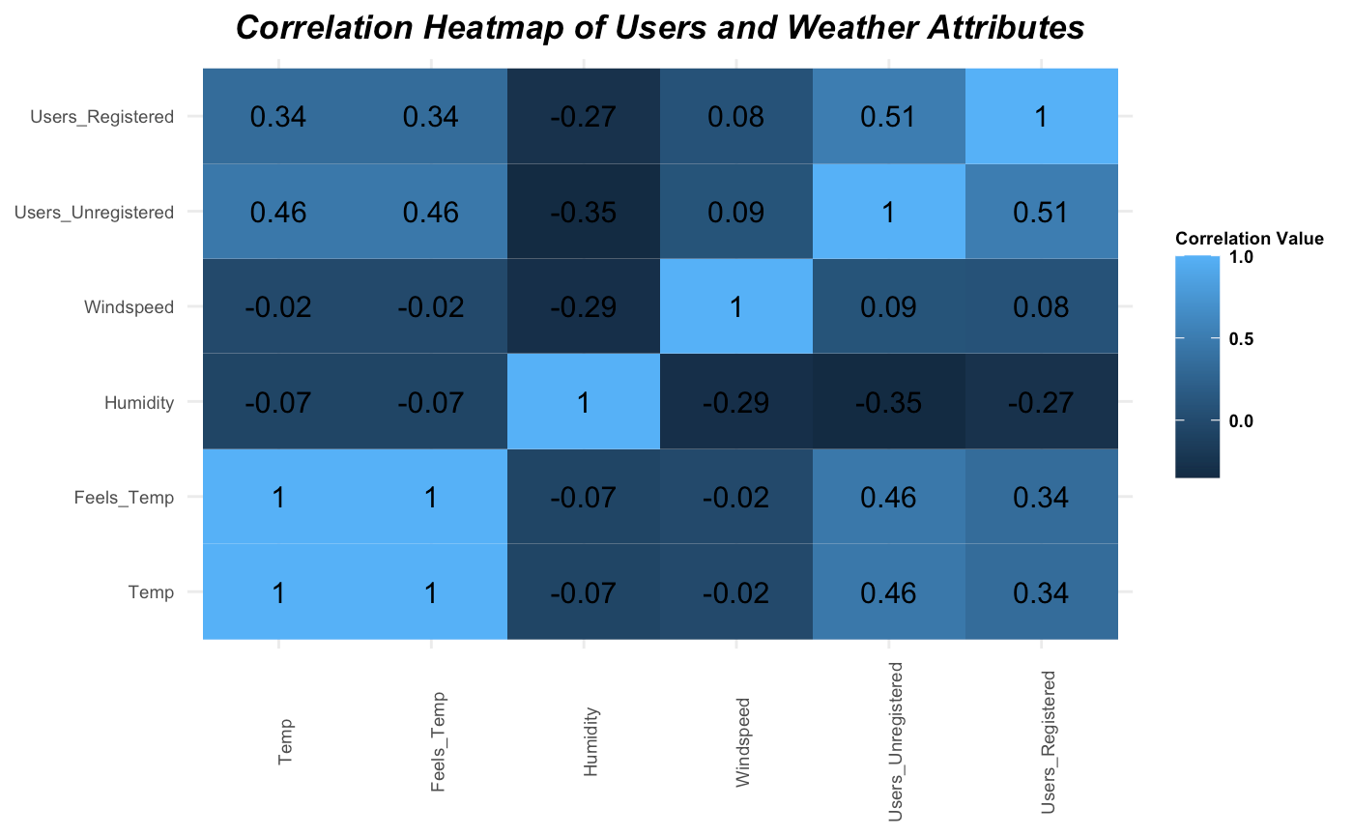

Correlation Heatmap
As we can see, number of users (both registered and unregistered) is positively correlated with the temp.
As the temp goes up, more users tend to go biking.

Slide 14

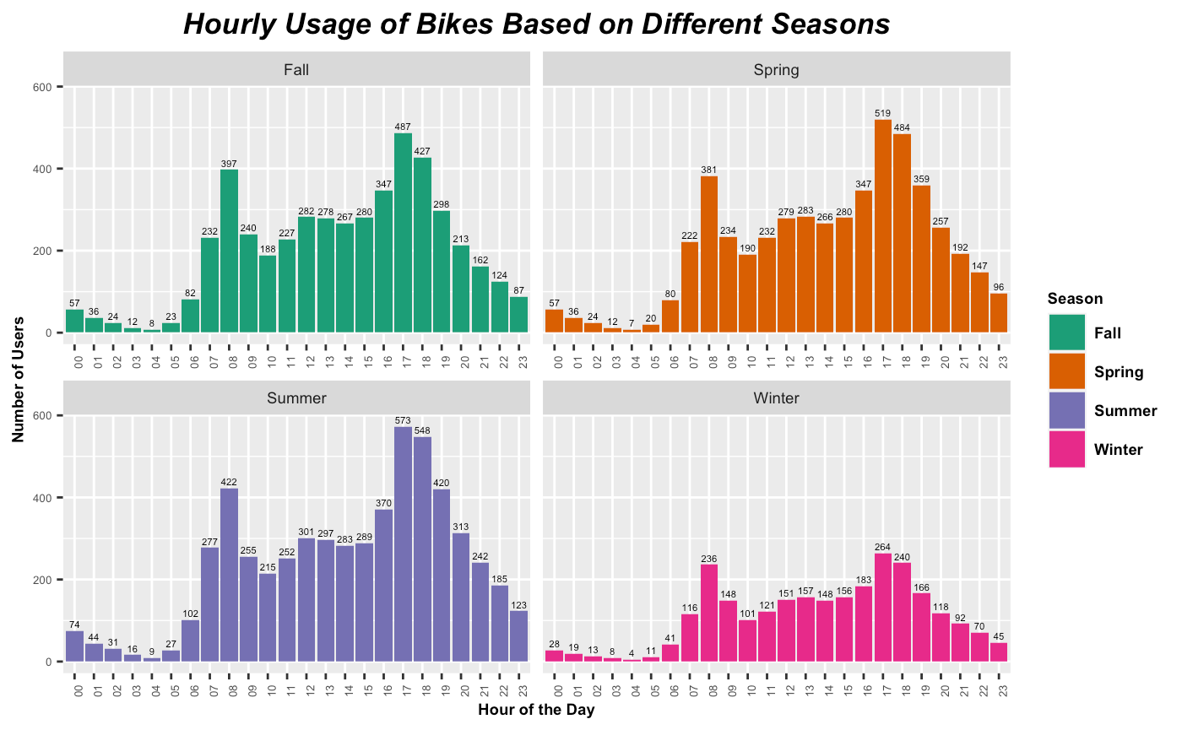
Season-Wise Hourly Trends
This plot tells us the total number of users across all stations at different hours of the day.
The peaks at 5-7 pm in all seasons is usually because of the users returning from offices and schools/colleges.

Slide 15
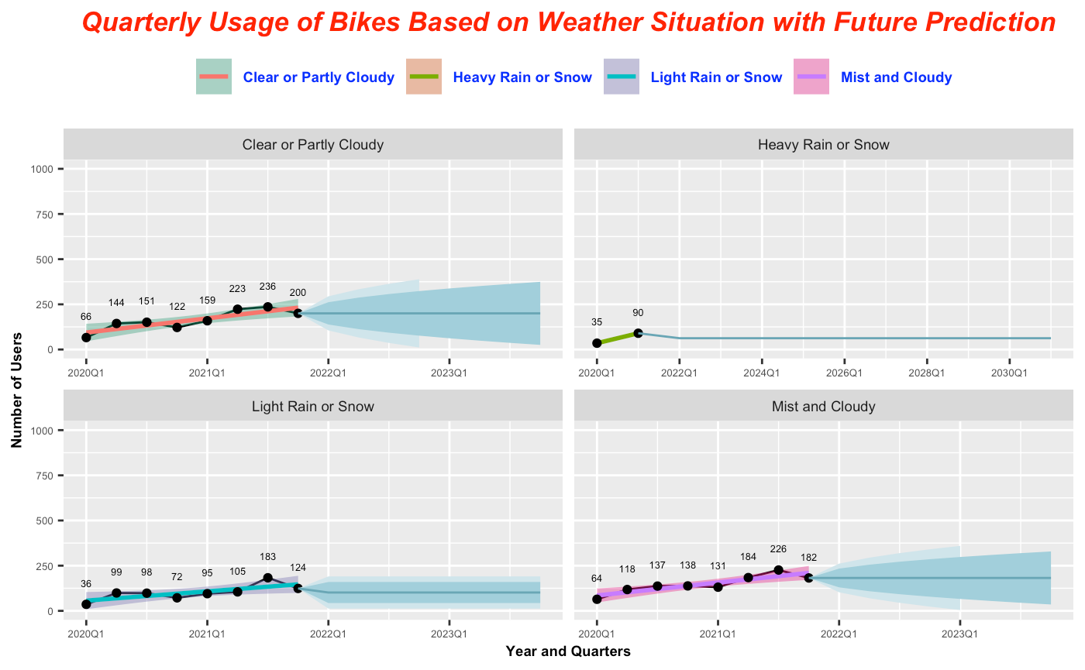

Weather Situation and Forecast
Based on analysis of number of users in different weather situations, following weather situations are most favorable for business:
Clean or partly cloudy
Mist and cloudy

Slide 16

Conclusion
YOY Growth of 65%
Most connected stations: CSP and Back Bay
Best season for business: Summer followed by Spring
Weather is most important factors. No of users increases in warmer weather
Weekdays are comparatively busier as compared to weekends
Public Holidays are less busy
Strongly related factors: Temp and No. of users
Busiest hours (5-7pm) are irrespective of season

Slide 17



Suggestions for Improvement
Increase Number of bikes at a station from where customers travel to different stations more frequently
Increase maintenance cycles at stations near seaport
Start rewarding loyal customers and start joining rewards for new registrations/subscriptions

Slide 18

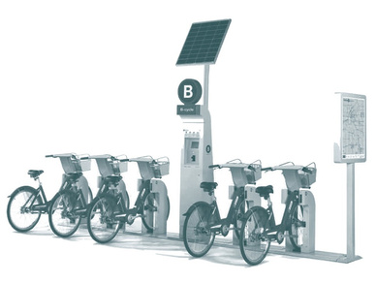
Suggestions Continued...
During heavy rains and snow, keep a very limited number of bikes out on stations and perform maintenace at warehouses
Restock the bikes at the stations between 12am to 4am as these are the least busy hours irrespective of seasons

Slide 19

Questions

Slide 20

Thank You!

